Slide 1

TRAVEL APP &CODE
PLAYGROUND APP
Sirigiri Charan Teja
MGSA_524
WIP-SF-13

Slide 2

2
CONTENTS
o Introduction
o Abstract
o Module - 1
o Module - 2
o Module - 3

Slide 3

INTR TION
Salesforce is a cloud-based software company that provides its customers with
a platform to develop their own applications without following the tough steps
that they used to follow in the legacy system. The software or application once
created can be uploaded onto the cloud allowing the end-users to view them.

Slide 4

ABSTRACT
In this Project we work on Creation of Travel App, with custom Objects and
fields and Flows to Automate the process of records, Creation of Approval
process, Modifying the user interface, Creating Reports and Dashboards for
analytics purposes and we also develop the Code Playground app through a
coding approach by using Apex Classes and Triggers, we extend the functional
capabilities of the App.

Slide 5

I N T R O D U C T I O N T O T R A V E L A P P
The travel approval project in Salesforce is a system designed to automate and
streamline the process of requesting and approving travel expenses for employees. The
project involves several components, including a custom object to track travel requests,
a custom approval process, and various integrations with external systems.

Slide 6

Module – 1
Ø This project module focuses on the non-coding approach
to modifying the user interface, as you customize an app
that tracks company travel.
Ø Create Custom App, Objects, Fields & Relationships, and
how you customize the App using declarative tools.

Slide 7
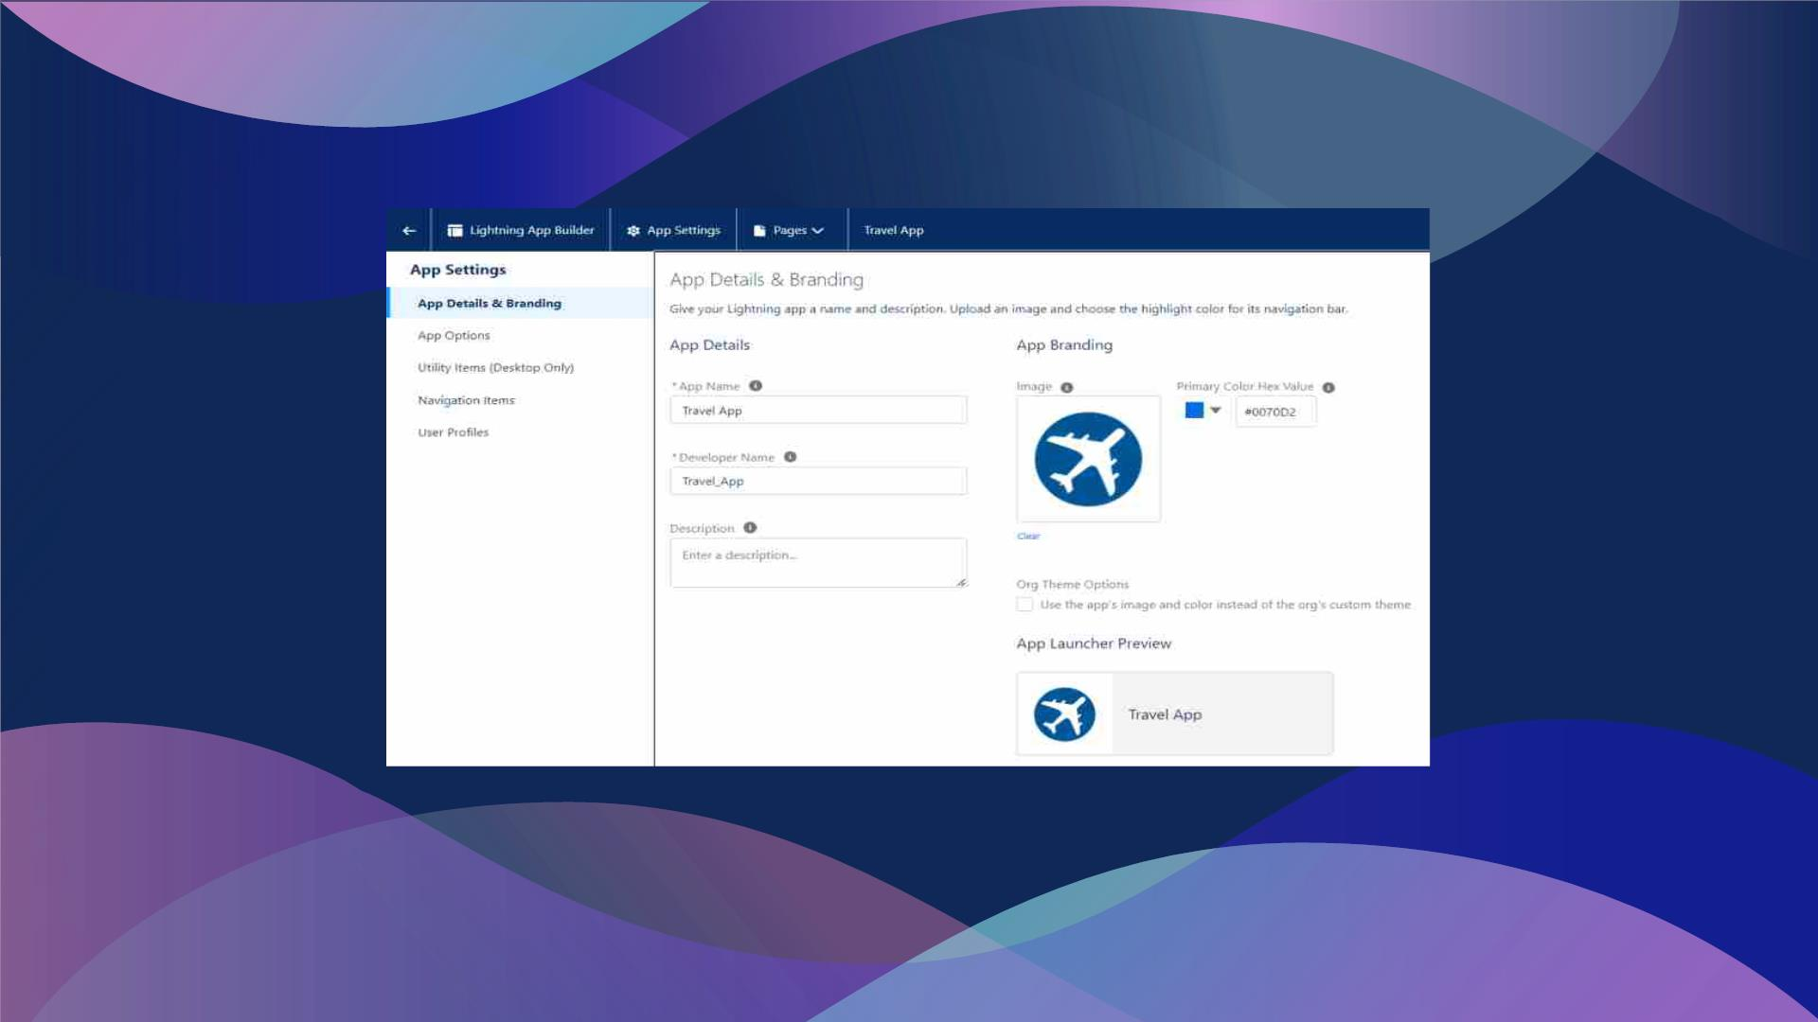
Created Lighting App : Travel App

Slide 8
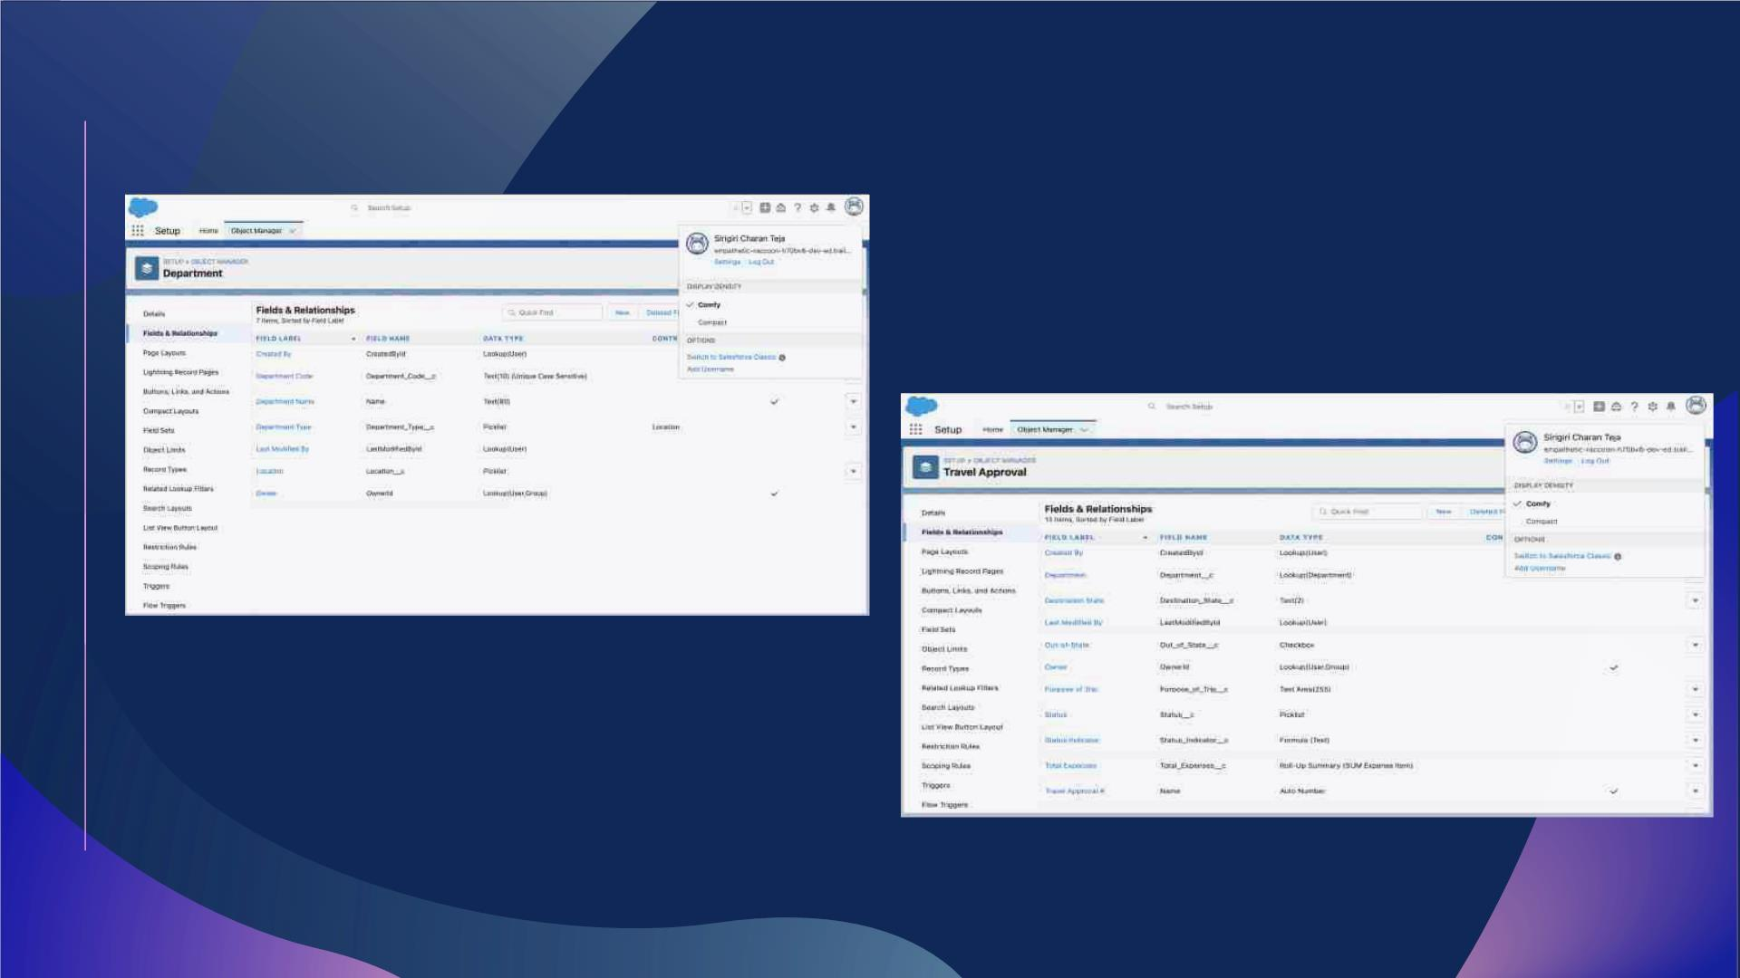
Created Department and Travel Approval custom objects and respective fields

Slide 9
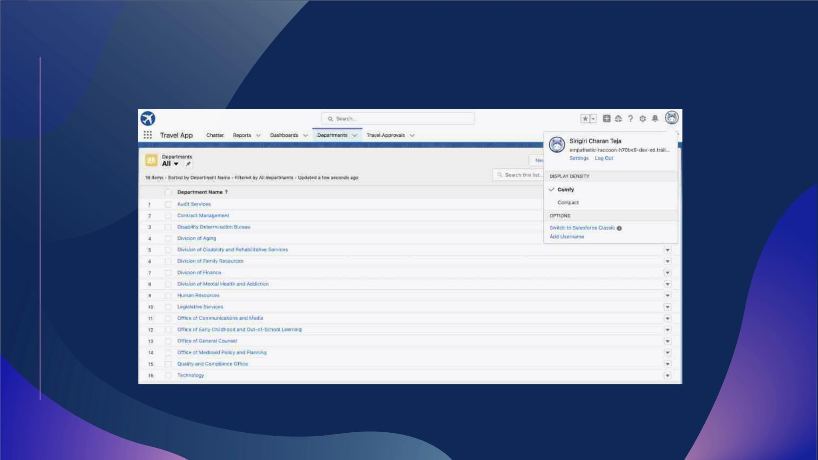
Import Department records using Data Import wizard

Slide 10
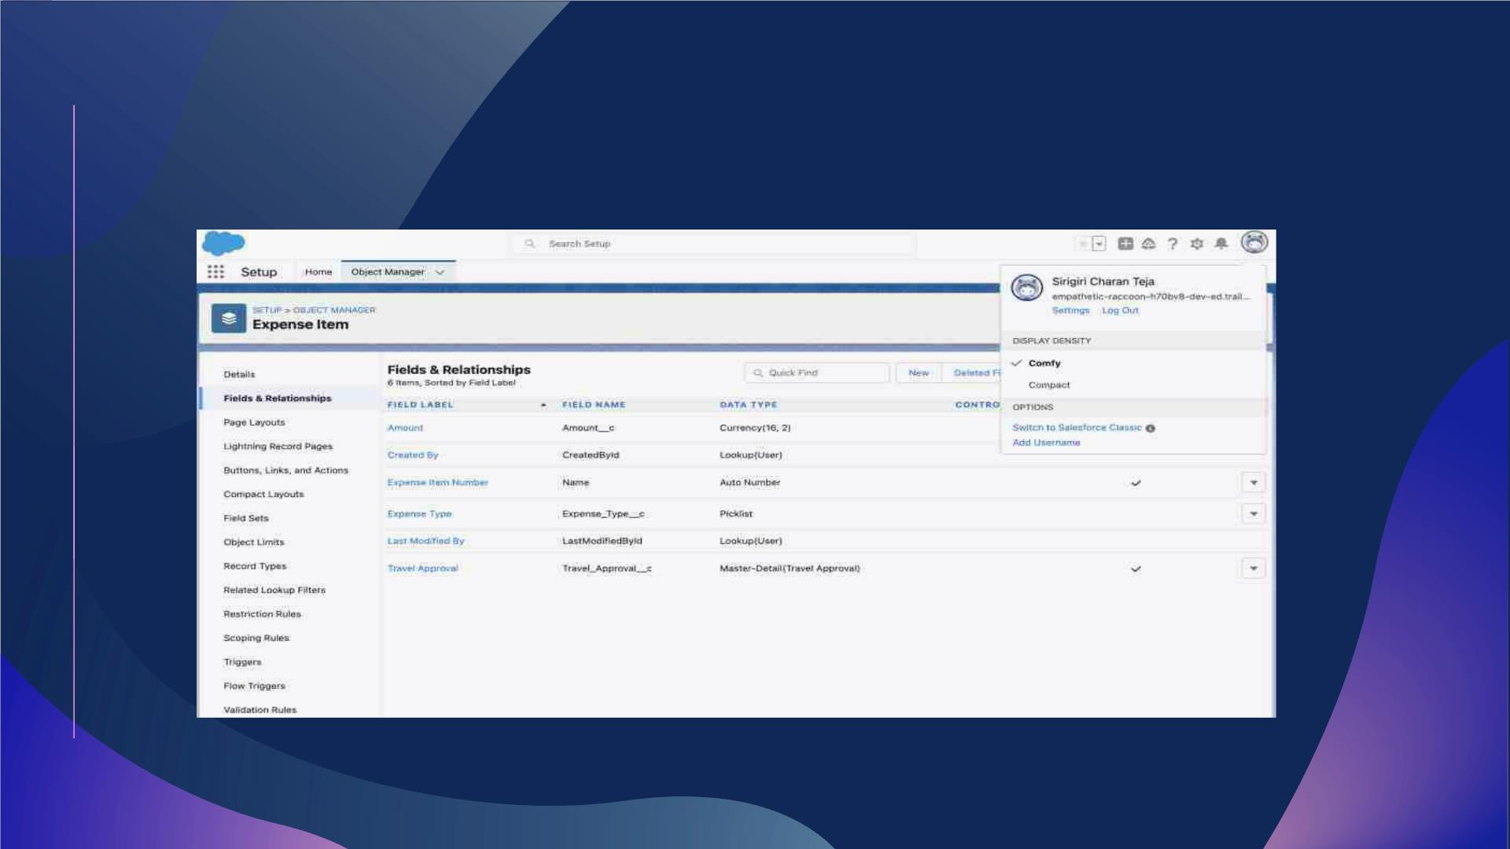
Created Expense Item Custom Object and respective fields

Slide 11
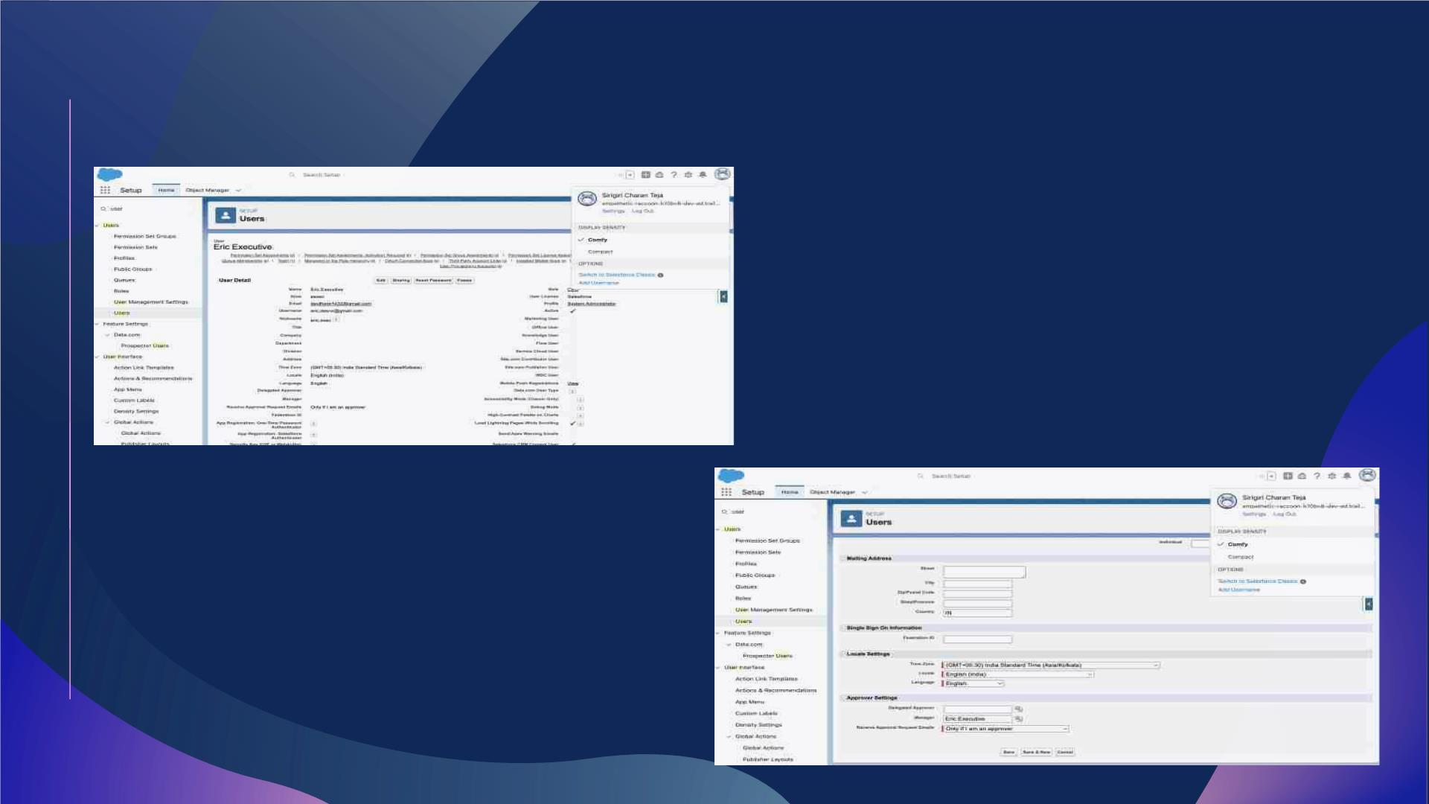
Created User Eric Executive and added as manager for me

Slide 12
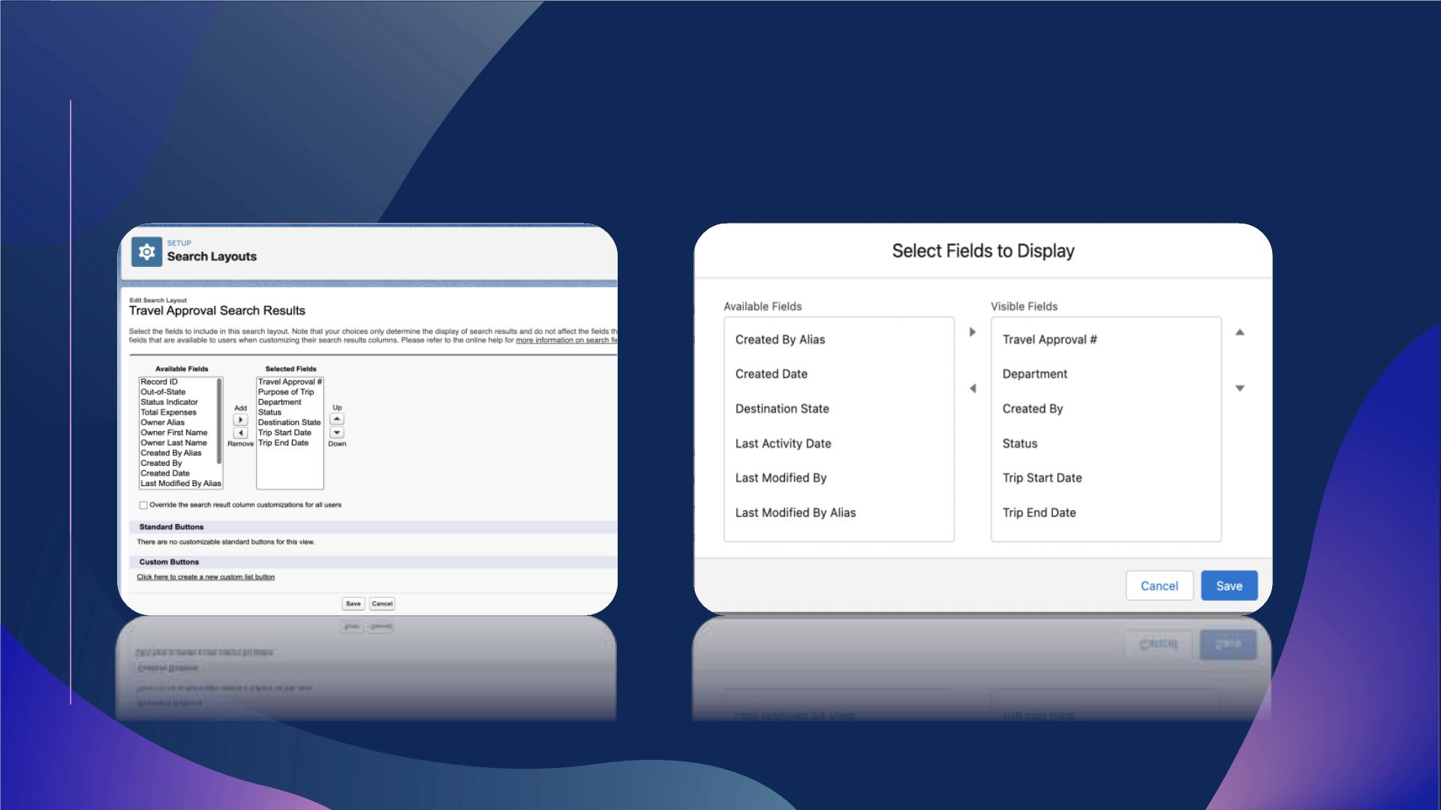
Customized the travel approval default search layout and list view

Slide 13
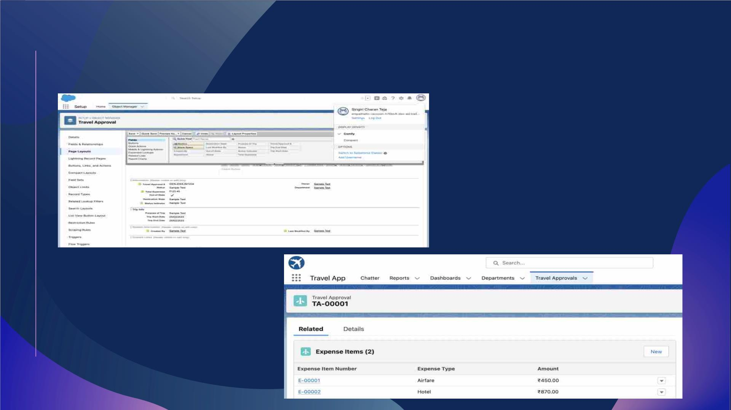
Customized Travel Approval Page Layout and Added Expense
item in Related List

Slide 14
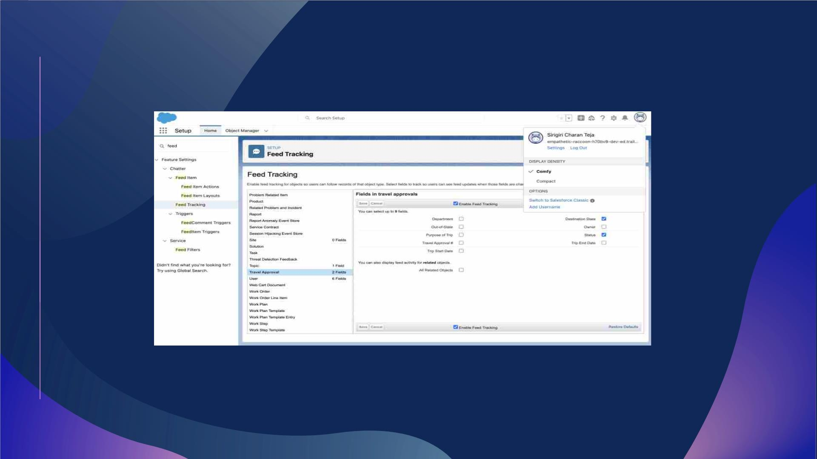
Enable Chatter on Travel approval Object

Slide 15
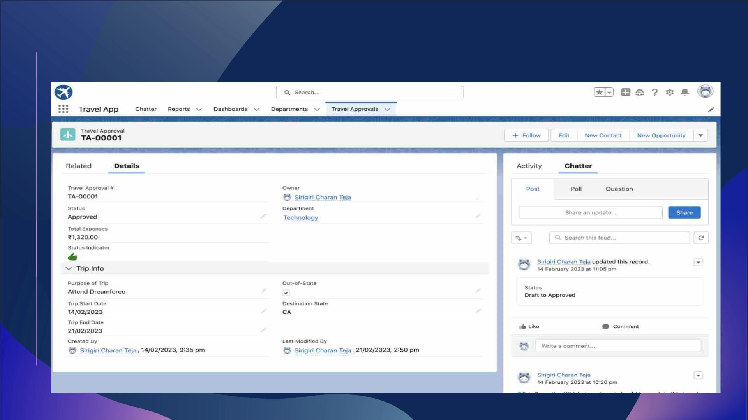
Overview of Travel Approval Record

Slide 16

Module – 2
ØIn this Module we add business logic and analytics to
the travel approval app to improve user Experience
ØValidation rules to enforce data integrity
ØAutomated the business process with flows

Slide 17
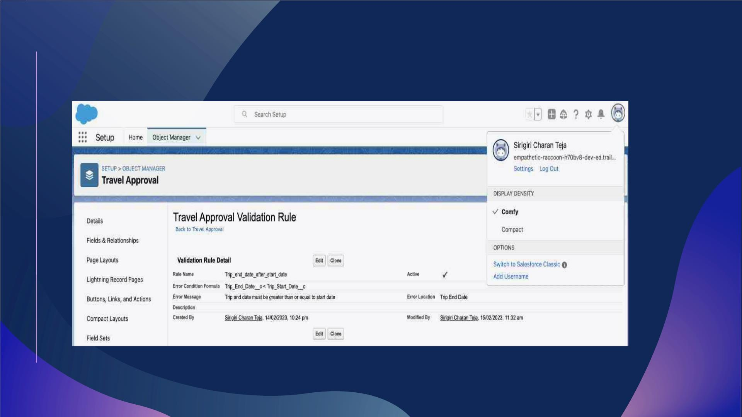
Validation rule to ensure Trip End date >Trip Start date

Slide 18
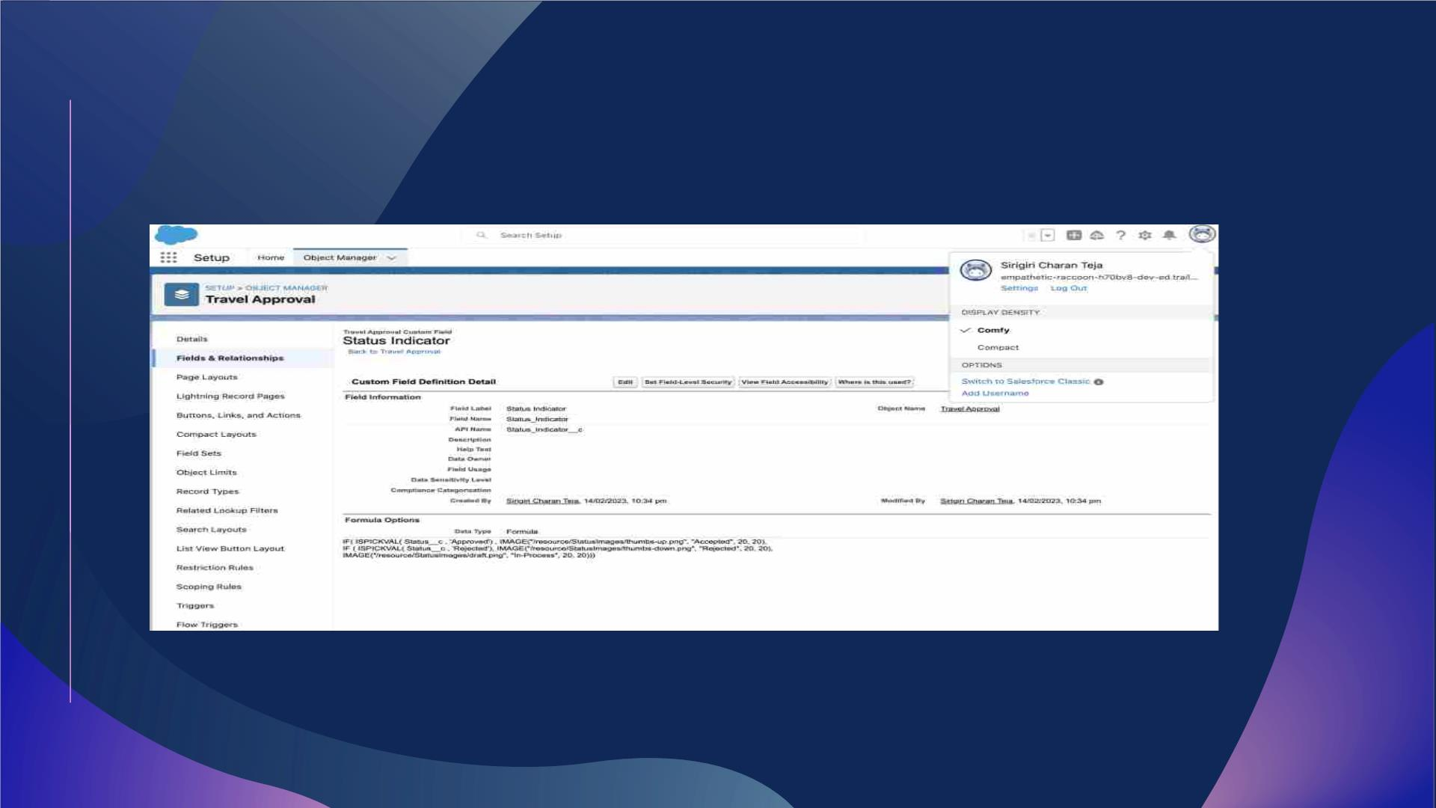
Formula Field to show Image based on status field on Travel
Approval Object

Slide 19
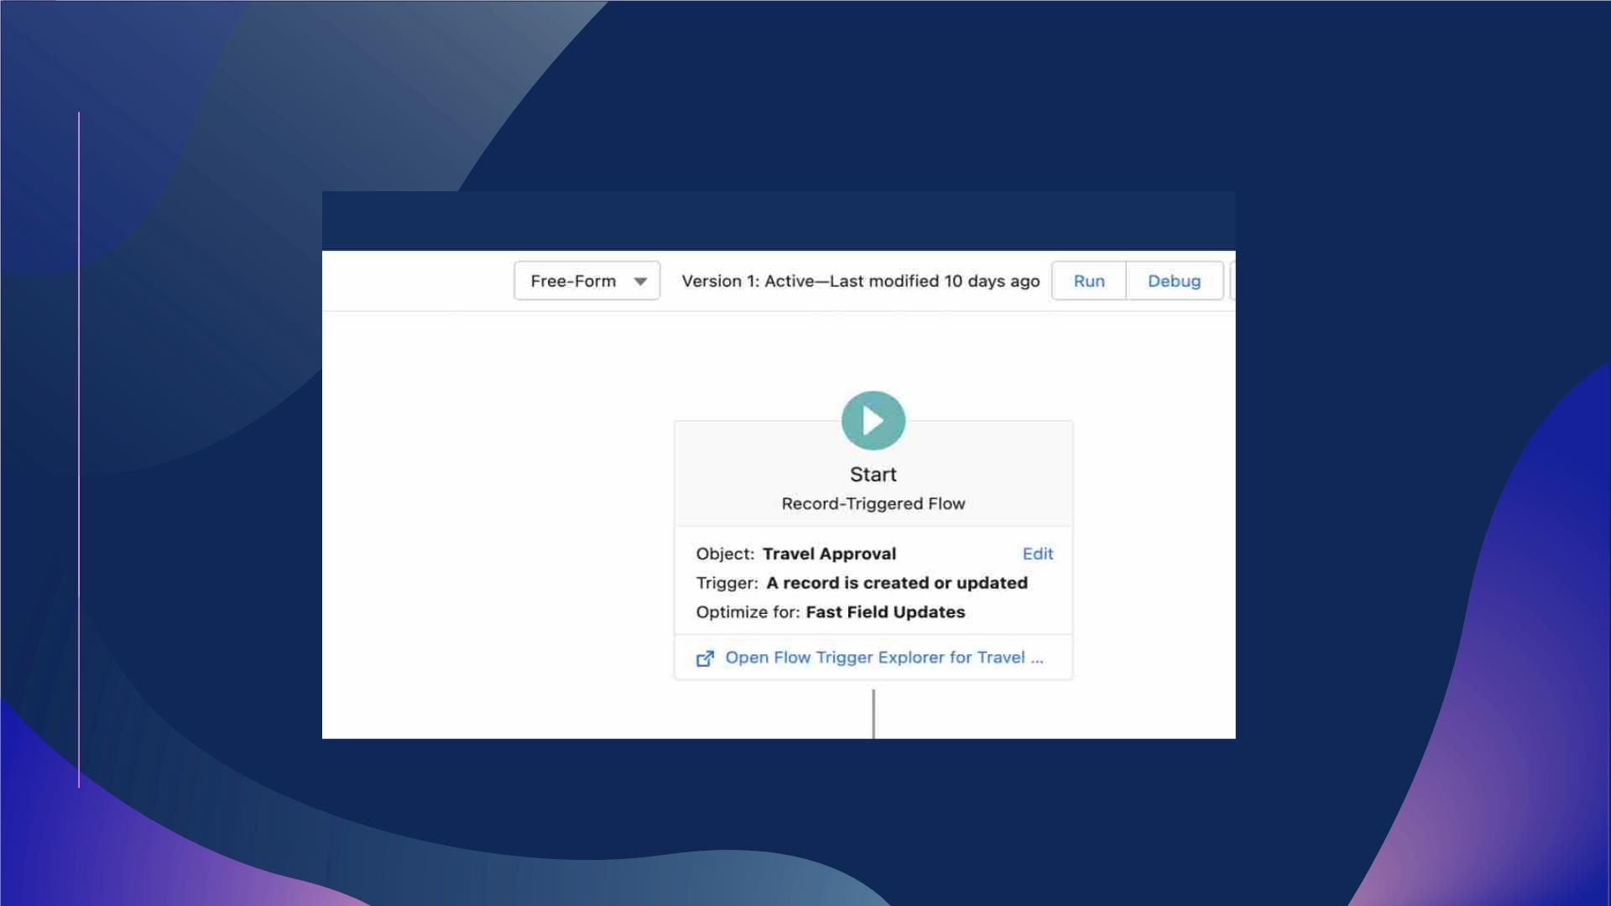
Created Out of State Travel Flag record triggered flow

Slide 20
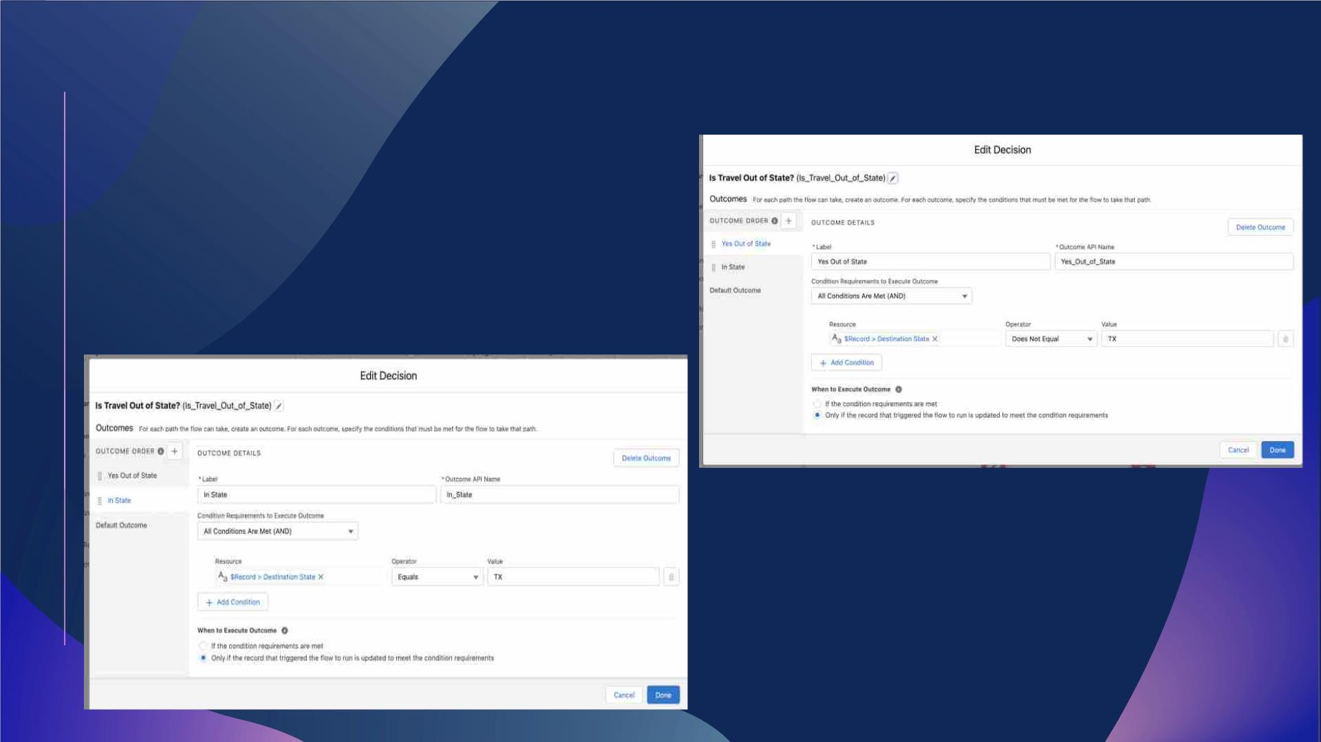
Add Decision Element to check the state is in or out

Slide 21
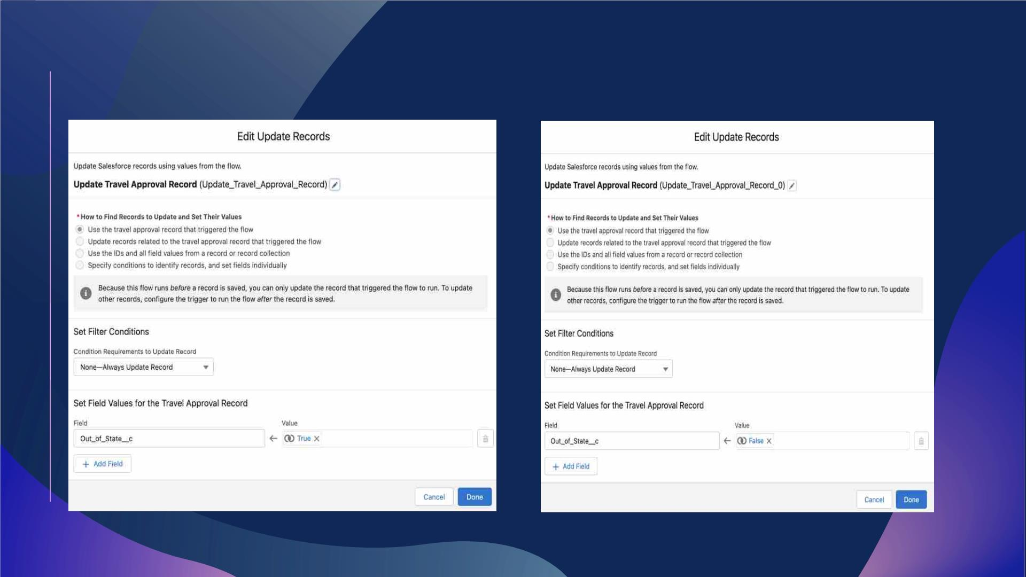
Update the Travel Approval Records when Travel is In state or out of state

Slide 22
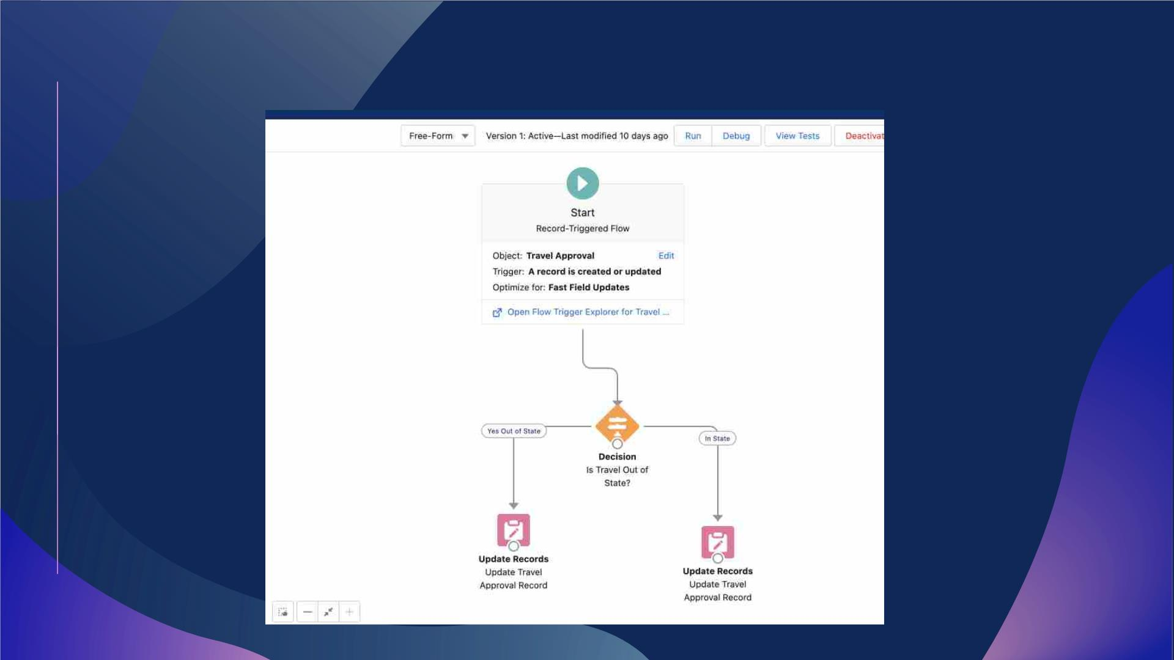
Flow Screen

Slide 23
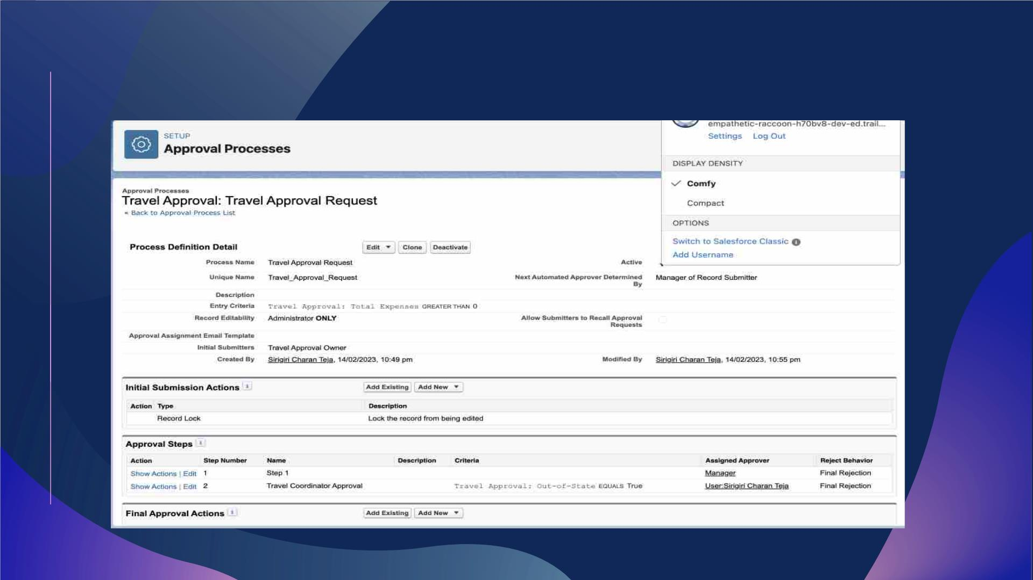
Created an Approval process for Travel Approval Request

Slide 24
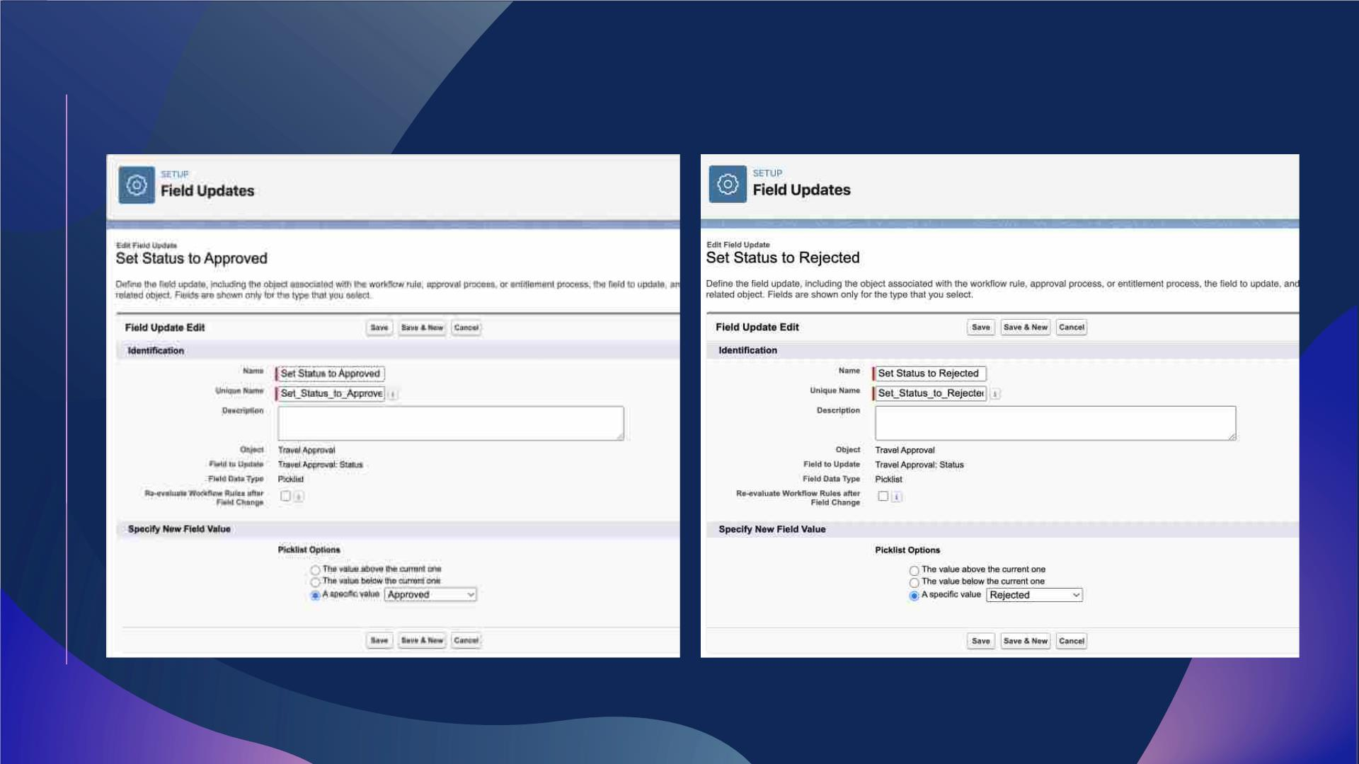
Created Final Approval and Rejection Actions

Slide 25
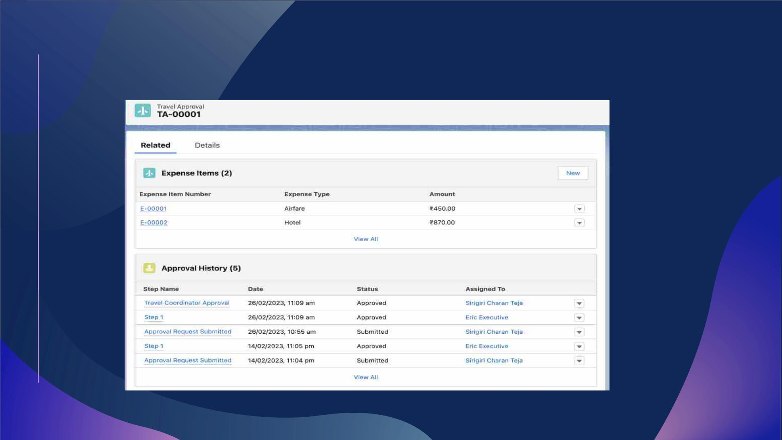
Tested the Approval Process

Slide 26
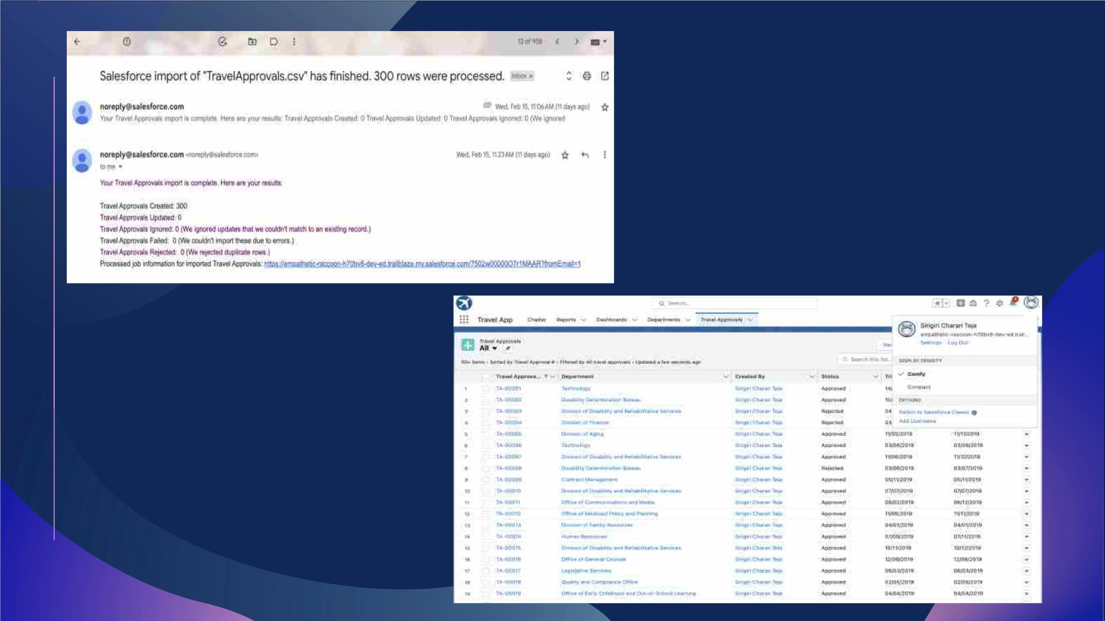
Imported Travel Approval
Records Using Data Import
Wizard

Slide 27
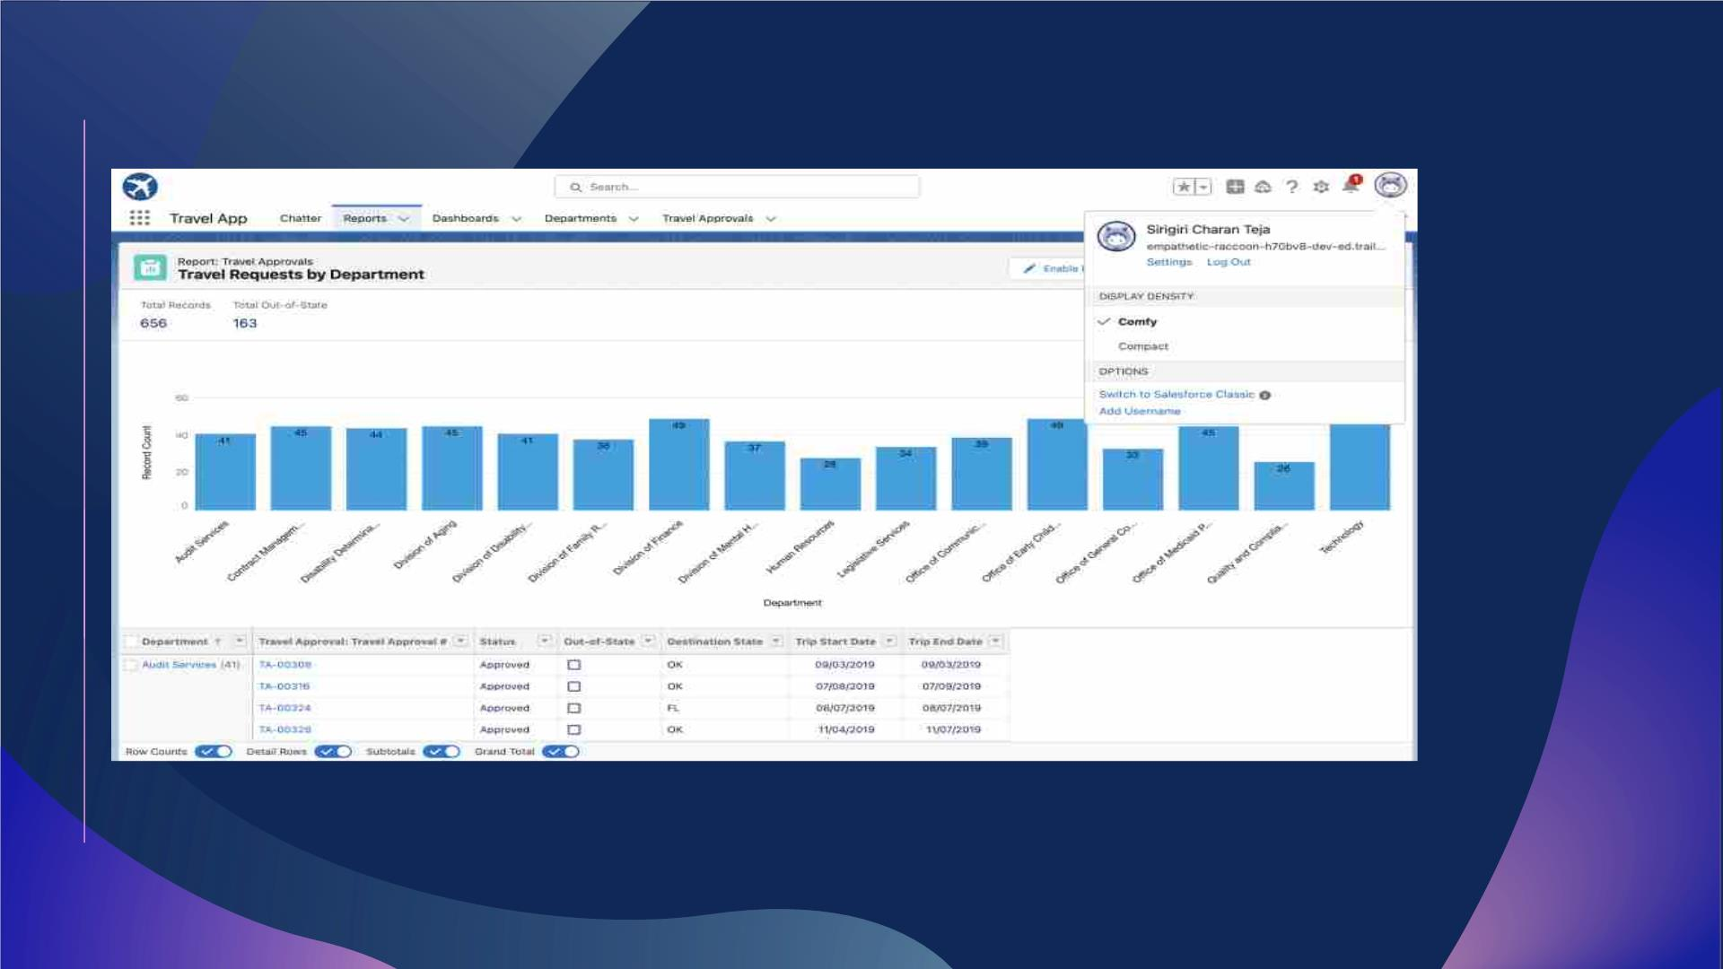
Created Travel Requests by Department Report

Slide 28
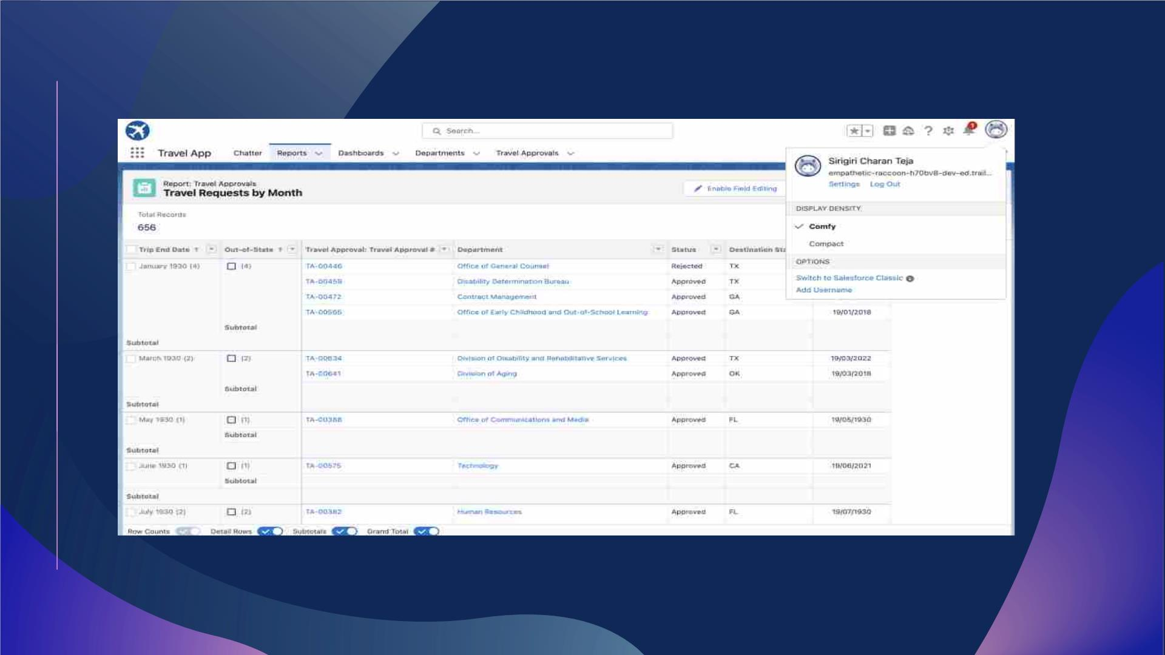
Created Travel Requests by Month Report

Slide 29
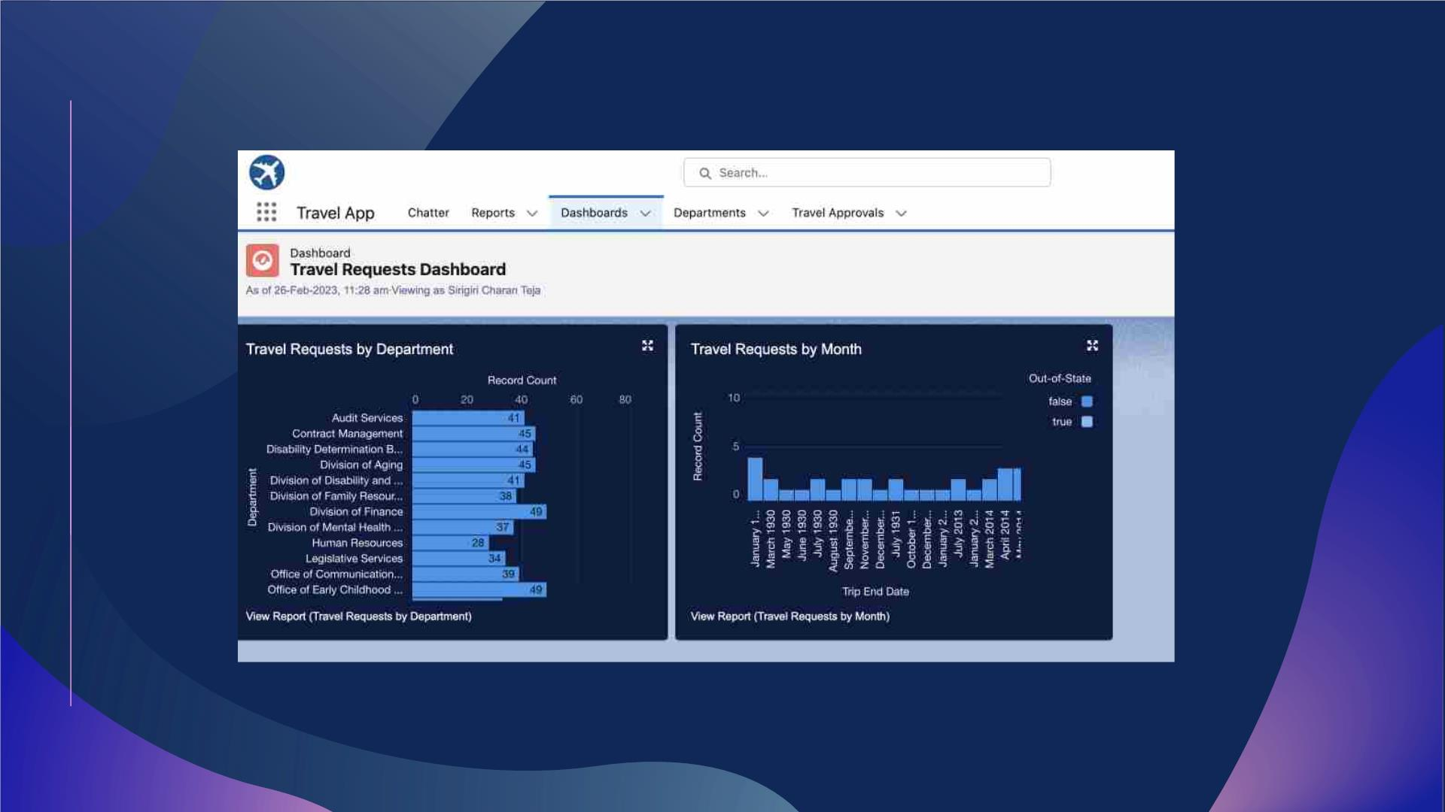
Created Travel Approvals Dashboard

Slide 30
Module - 3
Ø This Module focuses on the coding approach to extend the functional
capabilities of the Code Playground App.
Ø Apex enables to build complex business processes, customized user
interfaces and integration with third party systems.

Slide 31
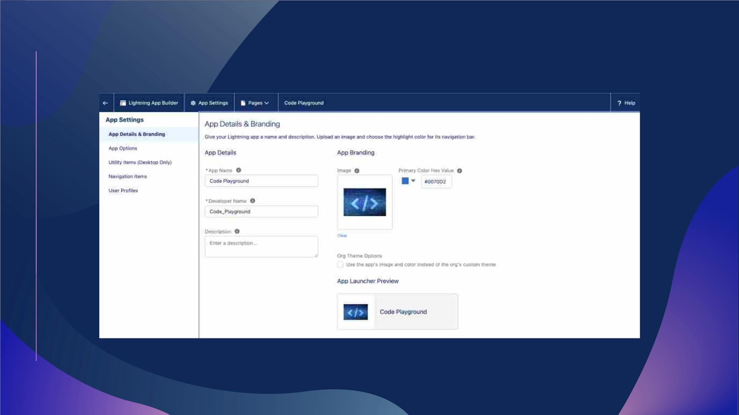
Created custom lightning app Code Playground

Slide 32
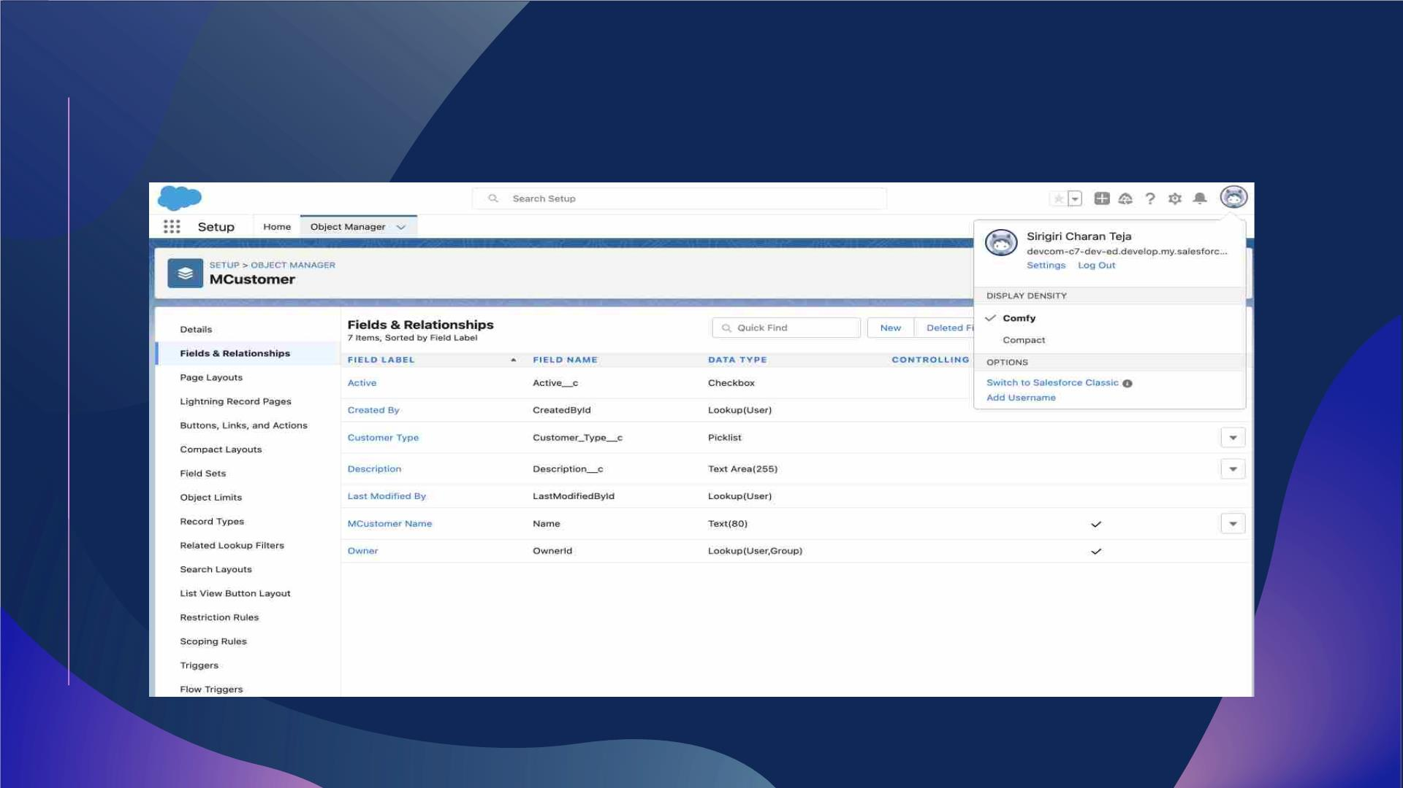
Created Customer Custom Object and respective
custom fields

Slide 33
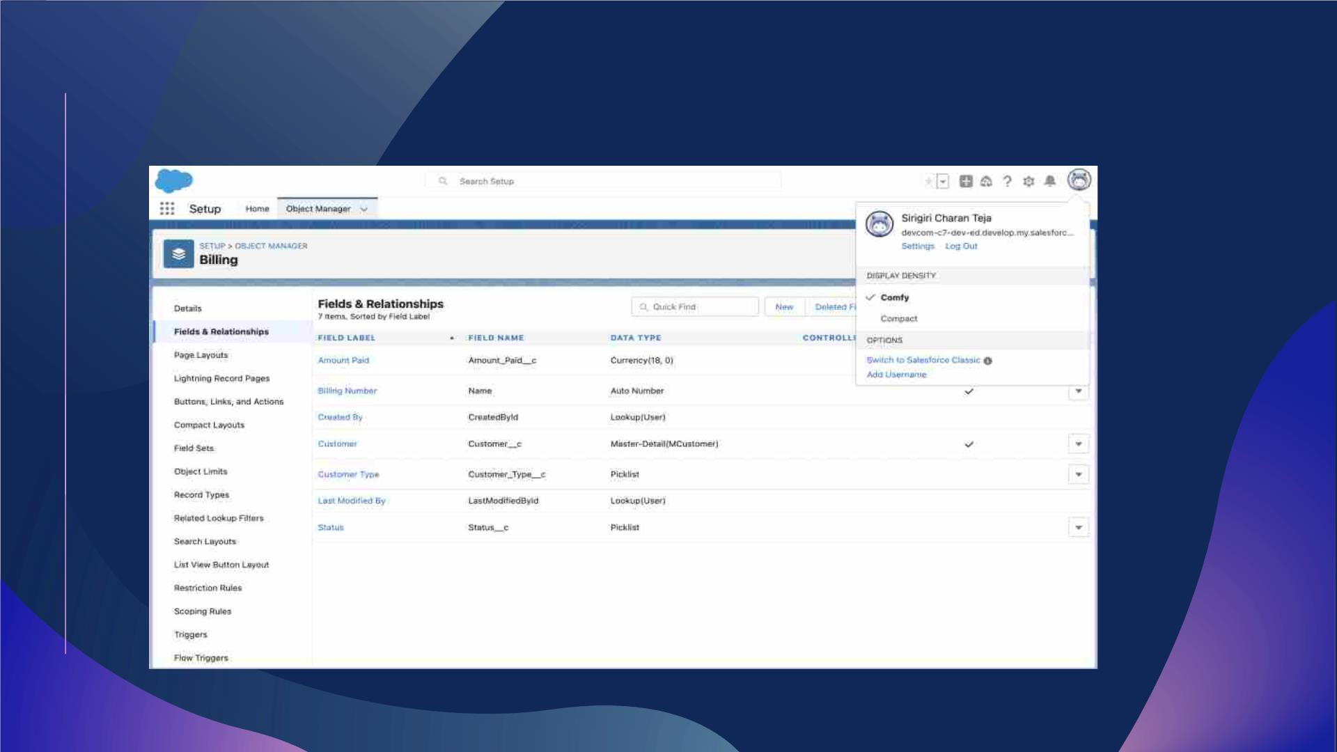
Created Billing Custom Object and respective custom fields

Slide 34
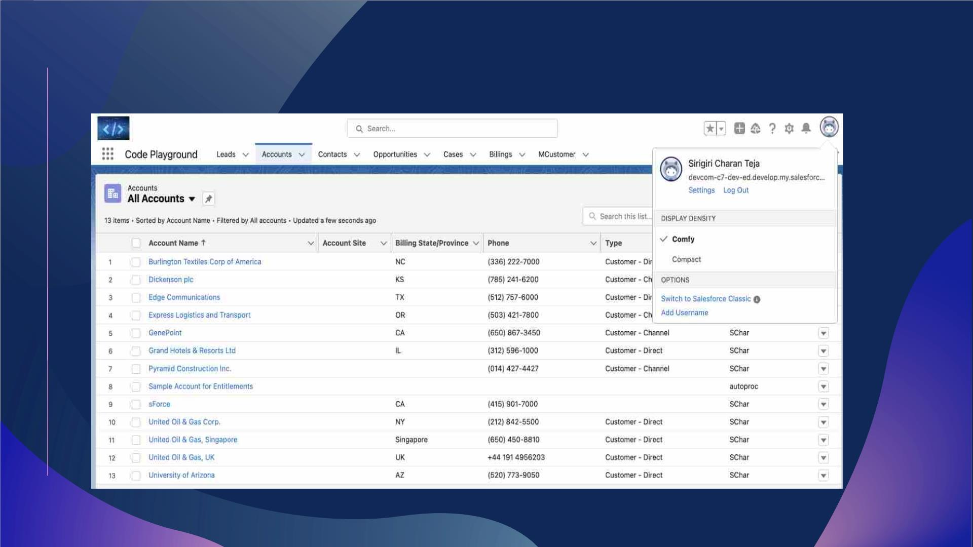
Code Playground App

Slide 35

THANK YOU
Sirigiri Charan Teja
MGSA_524
WIP-SF-13

